Slide 1
Invisible Threat Trailer

Slide 2
The Importance of Education Related to Immunizations
Mark H. Sawyer, MD
UCSD School of Medicine
Rady Children’s Hospital San Diego

Slide 3
Vaccines are good!
Vaccination is the top public health achievement of the 20th century
Most vaccines have had this magnitude of effect
Vaccines protect both directly in individuals and indirectly through community protection
CDC, Epidemiology and Prevention of Vaccine-Preventable Diseases, 9th ed., 2006; MMWR 1999; 48:241

Slide 4
Impact of childhood vaccines-1994-2013
731,000
Deaths
21,055,000 Hospitalizations
322,089,000 Illnesses
MMWR:April 25, 2014 / 63(16);352-355

Slide 5
But we are losing the battle…
 | 2008 | 2009 | 2010 | 2011 | 2012
DTaP 3 doses | 96.2 | 95 | 95 | 95.5 | 94.3
MMR | 92.1 | 90 | 91.5 | 91.6 | 90.8
Hep B | 93.5 | 92.4 | 91.8 | 91.1 | 89.7
MMWR/September 13, 2013 / 62(36);733-740

Slide 6
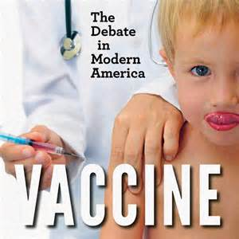
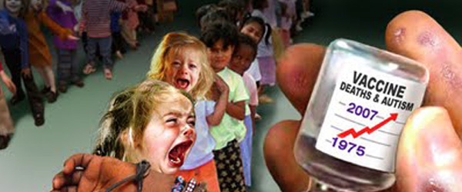

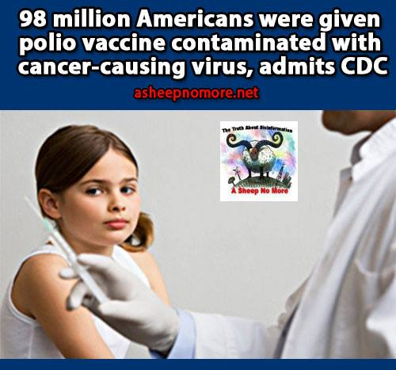

Slide 7
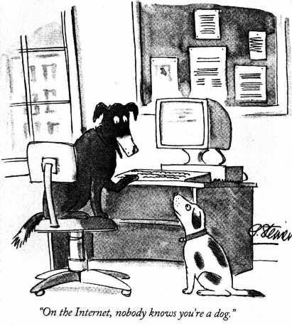
Know Your Source

Slide 8
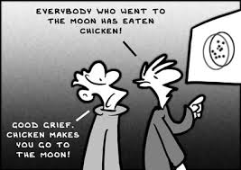
Temporal relationships

Slide 9


Vaccine Safety Datalink (VSD)
In 1990, the CDC started its Vaccine Safety Datalink project—VSD for short.
Eight large health maintenance organizations (HMOs) joined with the CDC to help keep an eye on vaccine safety.
Since its beginning in 1990, VSD has collected safety statistics on more than 7 million people who have received vaccines. These statistics are a powerful tool for assuring safety.

Slide 10
Why are some parents not immunizing their children?
Falsehood flies and the truth comes limping after so that when men come to be undeceived it is too late. The jest is over and the tale has had its effect
Jonathan Swift, The Examiner Nov. 9, 1710
Jonathan Swift, The Examiner Nov. 9, 1710

Slide 11
Personal Belief Exemptions (PBE) -California
Kindergarten Entrance Assessment 2001-2014
Exemption rates have been rising for more than a decade
Exemptions vary by region
Drop in exemption rates seen after “vaccine education” law passed
2014-15 California kindergartners= 535,234 (13,592 students with PBE status) among 8,170 schools
San Diego kindergarteners=43,827 (1,518 students with PBE status) among 609 schools

Slide 12
Community Protection
Fully Immunized Population
Partially Immunized Population

Slide 13
Community Protection
If a high enough percentage of the population is protected, disease does not spread
The threshold immunization rate needed to prevent transmission varies based on both the disease and the characteristics of the vaccine
The indication that we do not have community protection is outbreaks of disease
In an outbreak even some of the immunized develop disease because no vaccine is 100% effective

Slide 14
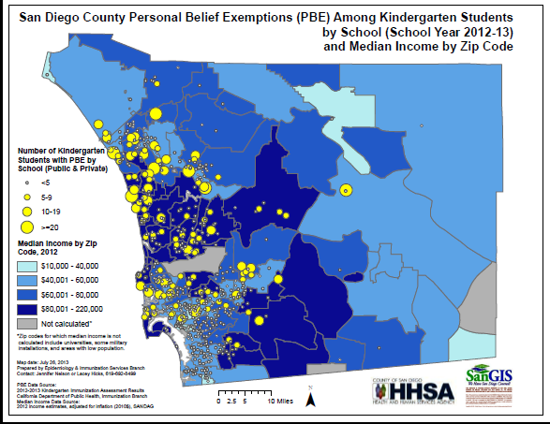
Herd immunity depends on what herd you are in!

Slide 15
Some challenges in communicating about vaccines
Vaccines don’t always work
Vaccines VERY rarely have serious adverse effects
Vaccines make people lose sight of the reasons we give them
It is human nature to assume a causal link between two things that are temporally associated
Low scientific literacy
Emotion trumps science

Slide 16
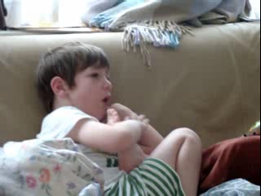
You do not want pertussis!
Violent coughing spells
The 100-day cough
Loss of sleep
Broken ribs
Death in infants

Slide 17


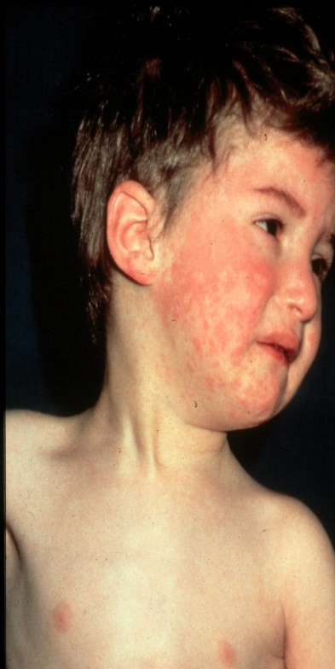
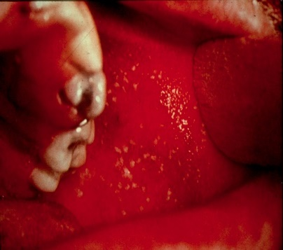
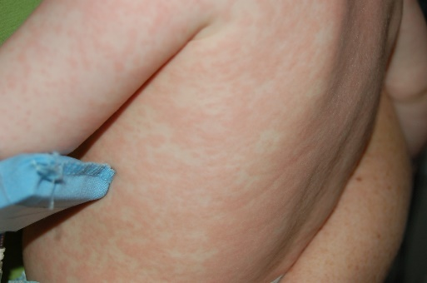
Measles!
111 cases linked to Disneyland
Most unimmunized or with unknown immunization
Cases spread to 7 states, Mexico and Canada
Some cases spread in healthcare locations
Children too young to be immunized were affected
MMWR, April 17, 2015 / 64(14);373-376

Slide 18
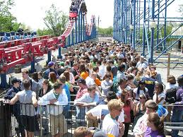
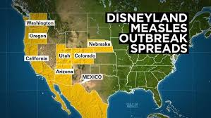
Issues emphasized during the 2015 Disneyland measles outbreak
Vaccine preventable diseases are still around
Some infections are extremely contagious
Exposures occur in everyday places
Our society is very mobile
It is hard to get the genie back in the bottle
The decisions of one person affect people
they don’t even know

Slide 19
Recent California Immunization Legislation
AB2109-2014
  Required that parents who wanted to exempt their children from school-mandated vaccines needed to provide a form from their child’s doctor that the parents had been informed about the risks and benefits of childhood vaccines. Allowed for a religious exemption
SB277-2015
  Eliminates all but medical exemptions for school-mandated vaccines. No religious exemption. n, no personal-belief exemption. Goes into effect in 2016.

Slide 20
Summary
Immunizations have saved millions of lives
The vast majority of parents choose to immunize their children
Vaccine-preventable diseases are still around and will make a comeback if immunization rates drop
Undervaccinated children cluster geographically
A parent’s decision to leave their children unimmunized threatens community protection and affects us all

Slide 21
Accurate Immunization Information
CDC/NIP (www.cdc.gov/nip)
American Academy of Pediatrics (www.aap.org)
American Academy of Family Physicians (www.aafp.org/)
National Network of Immunization Information (www.immunizationinfo.org)
Vaccine Education Center (www.vaccine.chop.edu)
Immunization Action Coalition (www.immunize.org)
Institute for Vaccine Safety (www.vaccinesafety.edu)
Vaccine Page (www.vaccines.org)
Every Child by Two (www.ecbt.org)
California Department of Public Health.gov (shot for shot)
Parents of Kids with Infectious Diseases (http://www.pkids.org/)
Voices for Vaccines (http://www.voicesforvaccines.org/)
Families Fighting Flu (http://www.familiesfightingflu.org/)

